Slide 1
CS490 RnD Presentation
Group Members:
Charishma Varala - 23B0984
Gunda Sushanth - 23B1063
Guide: Prof. Bhaskaran Raman

Slide 2
Problem: App to quantify poor cellular calls
The Gap: Cellular operators collect technical metrics, but lack data on "Quality of Experience" (QoE) from the user’s perspective (e.g., "I couldn't hear the other person").
The Contrast: VoIP apps (WhatsApp, Zoom) have built-in feedback loops; standard cellular telephony does not.
The Need: A mechanism to correlate subjective user feedback (Audio Quality) with objective network stats (Signal Strength) to identify "Dead Zones."

Slide 3
Proposed Solution
The project aims to build an Android app that captures user feedback after calls and uploads it anonymously to a server.
Automated Detection: An Android system that detects call termination without manual intervention.
Non-Intrusive UI: A floating "System Alert Window" overlay that gathers feedback immediately while the context is fresh.
Full-Stack Architecture: A dedicated Android Client and a Python Flask Backend for data aggregation.

Slide 4
Key Features
Automatic detection of call end events.
Floating overlay for quick, frictionless feedback.
Rating system + detailed audio/environment issue selection.
Secure network communication with configurable server IP.
High usability design with minimal user interaction required.

Slide 5
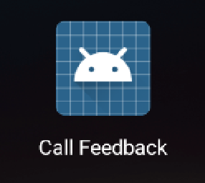
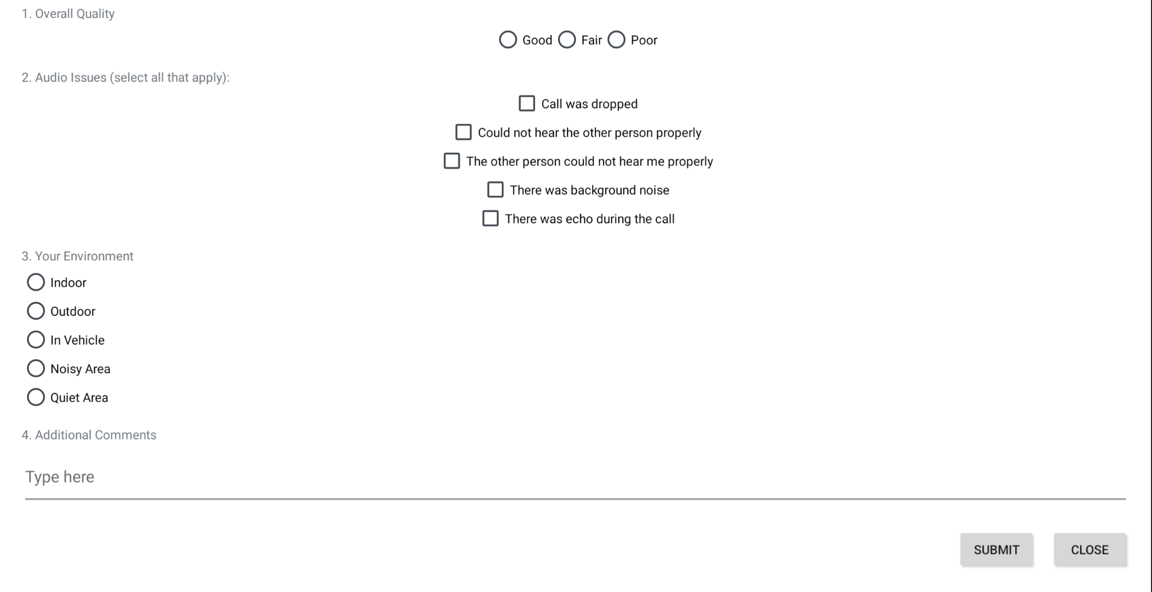
Application Workflow (UI)
Trigger: PhoneCallReceiver detects IDLE state (Call Ended).
Action: Launches OverlayService to draw over the home screen
Input: User selects:
  Rating: Good / Fair / Poor.
  Issues: Echo, Background Noise, Dropped Call.
  Context: Indoor / Outdoor / In-Vehicle.
  Comments
UI/UX to be updated
Notes:
"Let's look at the high level application workflow.
The Trigger: The workflow begins when our PhoneCallReceiver detects the phone state changing to IDLE.
The Action: This triggers the OverlayService, which draws this form you see on the screen directly over the Android launcher.
The Input: The user can quickly provide three data points:
A Quality Rating (Good/Fair/Poor).
Specific Issues (like Background Noise or Echo).
Context (Are they Indoor, Outdoor, or in a Vehicle?)."

Slide 6
Technical Flow
Overlay Permission Setup: The user uses MainActivity to navigate to OverlayPermissionActivity and grant the Draw over other apps (SYSTEM_ALERT_WINDOW) permission.
Call Detection: PhoneCallReceiver (a BroadcastReceiver listening to android.intent.action.PHONE_STATE) detects the transition from an active call state to a disconnected state.
Service Trigger: The PhoneCallReceiver starts the OverlayService.
Overlay Display: OverlayService inflates the UI defined in overlay_feedback.xml and displays it using the Android WindowManager.
Data Submission: Upon clicking the "Submit" button:
  FormLocalSaver handles local storage (e.g., for retry logic).
  ServerPoster packages the data into a JSON payload and sends an HTTP POST request to the backend.
Notes:
Here is the technical flow of a single feedback loop:
Permission Setup: First, the user grants the special 'Draw over other apps' permission.
Call Detection: The BroadcastReceiver listens for PHONE_STATE changes.
Service Trigger: Once the call disconnects, the Receiver starts the Overlay Service.
Display: The View is displayed using the WindowManager.
Submission: When the user clicks 'Submit', the data is saved locally via FormLocalSaver and simultaneously POSTed to the backend via ServerPoster."

Slide 7
System Architecture
Event Module: BroadcastReceiver listens for android.intent.action.PHONE_STATE.
UI Module: Background Service utilizing WindowManager and TYPE_APPLICATION_OVERLAY permission.
Data Module: Queries TelephonyManager (Signal) and FusedLocationProvider (GPS).
Backend Module: Python Flask server listening for JSON payloads.
Notes:
Our system architecture is divided into four modular components:
Event Module: The BroadcastReceiver acting as the trigger.
UI Module: The Background Service handling the TYPE_APPLICATION_OVERLAY.
Data Module: This is crucial—it queries the TelephonyManager for Signal Strength and FusedLocationProvider for GPS coordinates.
Backend Module: A Python Flask server that digests the JSON payloads."

Slide 8
Data Collection
Subjective Data (User Input):
Call Quality Rating (1-3 scale).
Specific Audio Artifacts (Choppy, One-way Audio).
Physical Environment (Indoor/Outdoor).
Additional Comments.
Objective Data (Sensor Readings):
Signal Strength: Measured in dBm .
Network Type: WiFi, LTE (4G), or NR (5G).
Location: Latitude/Longitude via Google Play Services.
Timestamp: Unix epoch time for temporal analysis.

Slide 9
Permissions
READ_PHONE_STATE : Mandatory for detecting call state changes.
SYSTEM_ALERT_WINDOW : Mandatory for drawing the overlay UI over other apps.
INTERNET : Required to post feedback data to the backend server.
ACCESS_NETWORK_STATE : Recommended for checking network availability before posting.
ACCESS_COARSE_LOCATION : Captures approximate device location for feedback metadata.
ACCESS_FINE_LOCATION : Captures precise location metadata during feedback.
ACCESS_BACKGROUND_LOCATION : Needed if location is captured when the app is in background.

Slide 10
Backend Implementation
Server Tech: Python Flask running on local network IP (0.0.0.0 binding).
Data Persistence: Uses JSON Lines (.jsonl) format.
  High-performance append operations (O(1)) and robust against corruption compared to complex databases.
API Endpoint: RESTful /feedback route handling HTTP POST requests with error handling for malformed payloads.

Slide 11
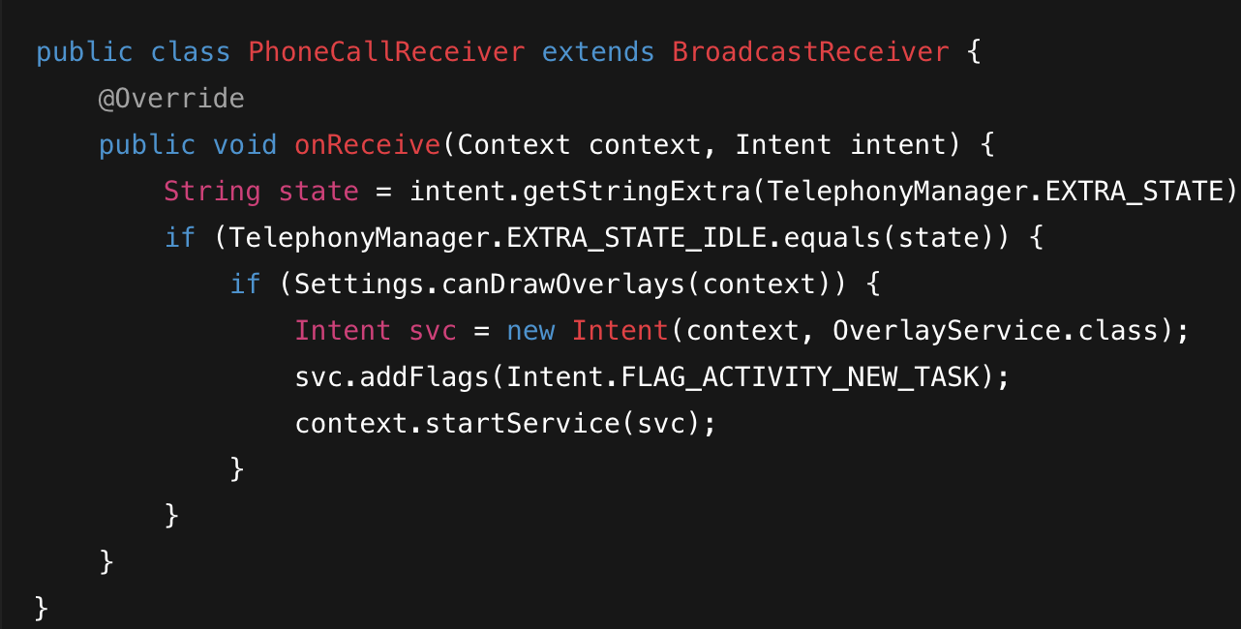
Broadcast Receiver
Listens for phone call state changes using Android’s TelephonyManager.
Detects when a call starts, ends, or changes state.
Triggers the overlay feedback form immediately after the call ends.
Runs in the background with minimal resource usage.
Acts as the event entry point for the entire feedback workflow.
Notes:
Here is a snippet of our core detection logic.
You can see the onReceive method checking for TelephonyManager.EXTRA_STATE. When it equals EXTRA_STATE_IDLE 12, it checks for overlay permissions and immediately starts the OverlayService13. This ensures the app runs in the background with minimal resource usage."

Slide 12
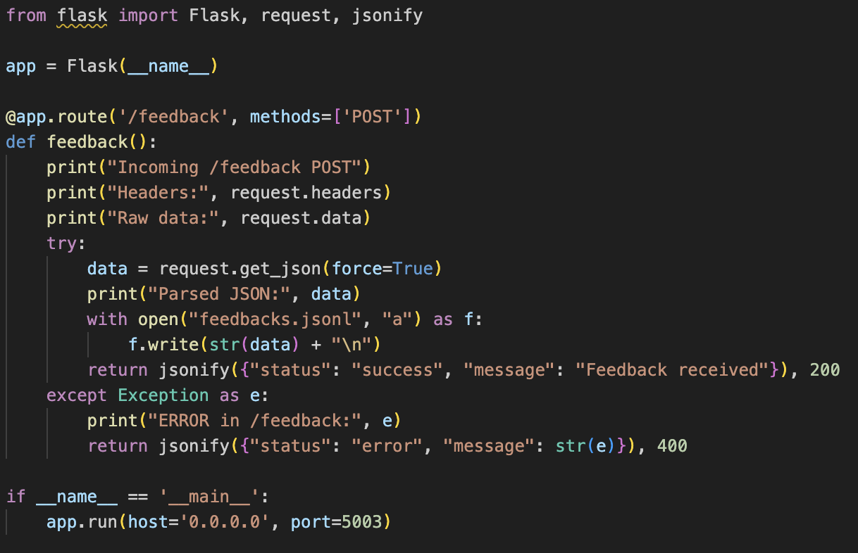
Server Side
Lightweight Python HTTP server that receives POST requests from the app.
Stores each feedback entry in a JSON Lines (.jsonl) file for analysis.
Operates anonymously — no personal data or identifiers captured.
Enables future data processing, analytics, and visualization.

Slide 13
Technology Stack
Android (Java): Main development platform.
System Services: TelephonyManager, BroadcastReceiver, Overlay Service.
UI: XML-based layouts for launcher and feedback screens.
Networking: HTTP POST requests using Java networking libraries.
Backend: Python Flask/HTTP server logging data into JSONL.

Slide 14
Observations
Successful end-of-call detection across test devices.
Overlay consistently appears without delays or interruptions.
Feedback successfully posted to local Python server.
Notes:
"Our testing yielded positive results:
We achieved successful End-of-Call detection across multiple test devices.
The overlay appears consistently without delay.
Most importantly, the data logs show meaningful variation, successfully capturing the correlation between signal strength and user ratings."

Slide 15
Implementation Challenges
Handling phone state permissions on modern Android versions.
Overlay permission requirements and UI rendering over other apps.
Cleartext HTTP restrictions requiring network security configuration.
Ensuring overlay does not conflict with system UI or accessibility settings.

Slide 16
Future Scope
Move backend to cloud with database support (Firebase / AWS / Supabase).
Data Visualization: Build a web dashboard to plot feedback coordinates on a map to visualize dead zones.
iOS Adaptation: Investigate Push Notifications to trigger feedback on iPhones (due to lack of Overlay support).
Predictive AI: Train ML models on the server to predict "Call Drop Probability" based on signal trends.
Notes:
For future work, we propose
Visualize Data: Build a web dashboard to plot these coordinates as Heatmaps to visualize dead zones.
Predictive AI: Train ML models to predict call drops based on signal trends.
iOS Adaptation: Investigate push notifications for iPhones since they don't support overlays.
Cloud Migration: Move from local JSON files to a scalable cloud database like Firebase or AWS."

Slide 17
THANK YOU !

